Slide 1

Senior Insights Analyst Assignment
Panagiotis Stavrianos
panagiwthssstav@gmail.com

Slide 2
Contents
Dataset
Explanatory Data Analysis
Clustering
Dashboard

Slide 3
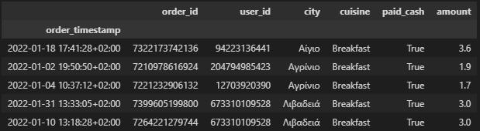
Orders Dataset
Orders in the efood platform spanning from 2022-01-01 02:06:07 (UTC+2) up to 2022-02-01 01:59:53 (UTC+2) performed by customers
Transformed into .parquet for reducing redundant space

Slide 4
Orders Dataset
user_id (hashed), as unique identifier for each customer
order_id (hashed), as unique identifier for each order
cuisine, as a description for type of food
city, as the main city where the order was executed
paid cash, as if the customer paid with cash or card
amount, as the total amount of each transaction (in EUR)
The amount feature contains the prices, and it is assumed that are in EUR.

Slide 5
Explanatory Data Analysis

Slide 6
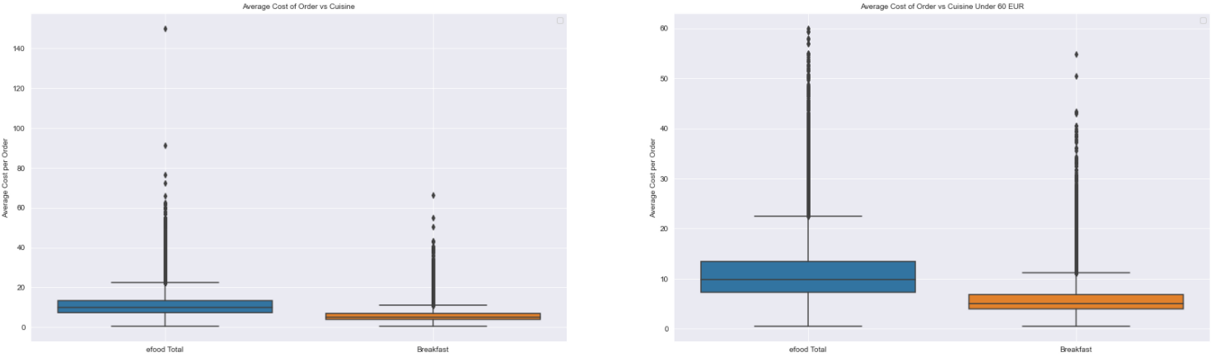
Cuisine
Cuisine is clustered into efood Total and Breakfast
In general, Breakfast presents comparably less average amount per order compared to efood Total

Slide 7
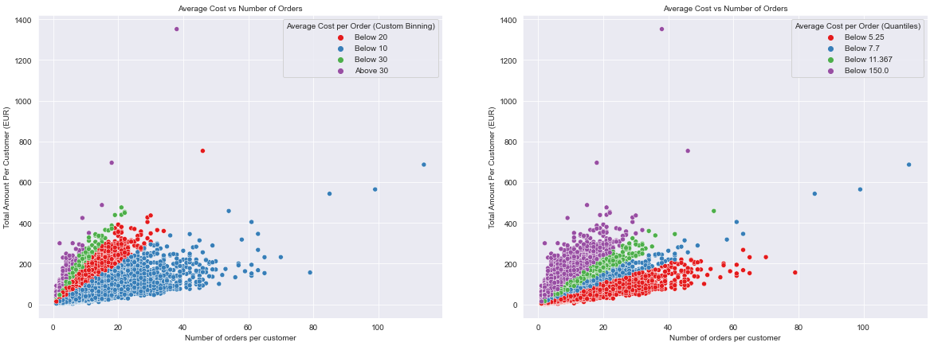
Customer
Analysis of 121943 unique customer while 81108 unique customers with > 1 order
75% performing orders below 12 EUR with 2 brief types of customers:
small-cost transactions and high frequency
high-cost transactions and small order frequency

Slide 8
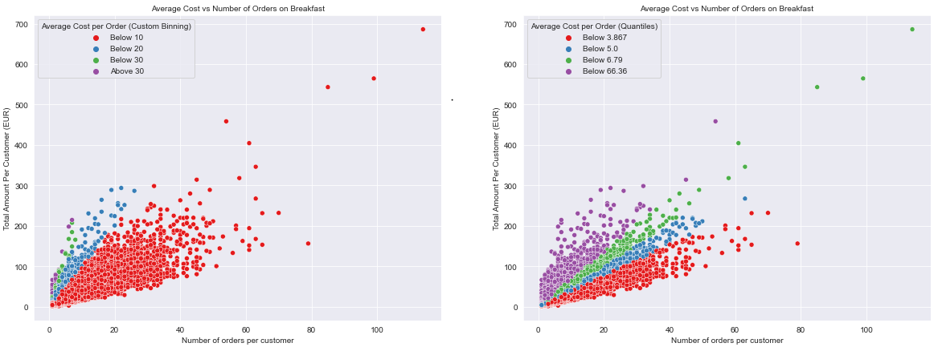
Customer (Breakfast)
Breakfast is restricted in 7 EUR (75%) for average cost per order
Small amounts on regular basis
For final analysis, dataset is restricted only to users with > 1 order

Slide 9
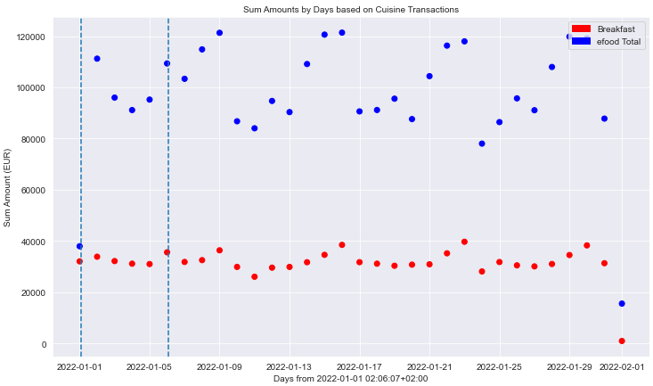
Daily Cuisine
Special days (Public Holidays) in week present increased # of orders
Except Holidays, such as 01/01/2022, where Christmas was preceded
General seasonality
Increasing trend towards weekends
Decreasing into start and mid-week

Slide 10
Modelling

Slide 11
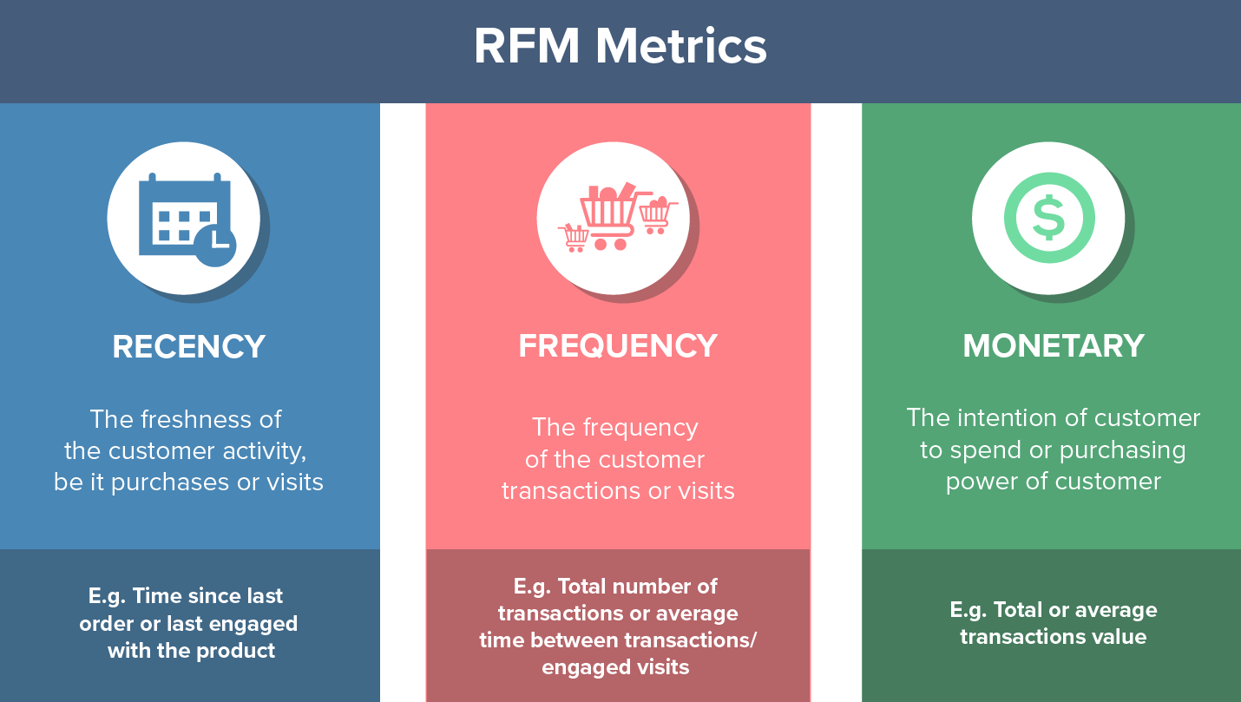
How to quantify behaviour?
Based on Pareto Principle
Understand the “value” for each individual customer
Segmentation on diverse groups for developing different marketing strategies

Slide 12
FM Analysis
In the assignment, frequency and order value are determined to be the main variables
Recency is avoided and monetary value is determined as the mean order value for each customer
Analysis can be conveyed through 2 main strategies:
Clustering in each individual feature, score each cluster per feature and add the overall points
General clustering approach with all features and inference each cluster
In this assignment, the individual feature clustering does not present any meaningful clusters and the general clustering approach on all features is executed.
Improvement: Additional features in clustering, such as average cost, recency, cash, cuisine,..

Slide 13
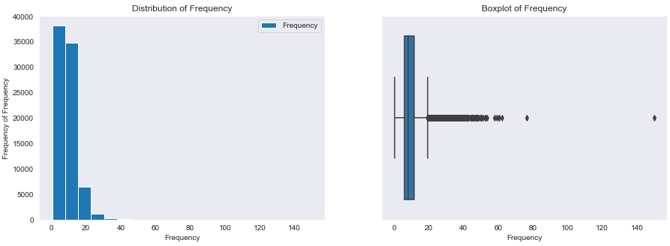
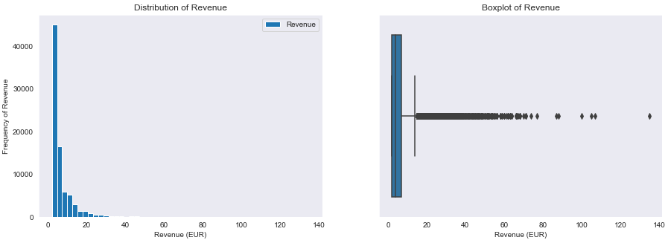
FM Analysis

Slide 14
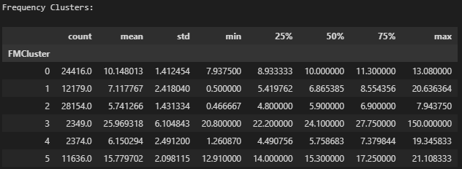
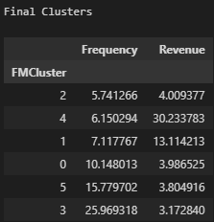
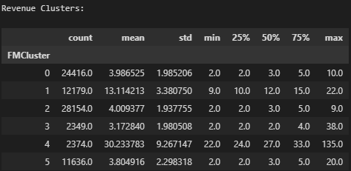
Clustering FM
KMeans clustering on standardized FM features
Creation of 6 Clusters (Elbow Method)
Cluster 2: Churn-risk users
Cluster 4-1: Low Value users
Cluster 0-5-3: High-value users with high frequency

Slide 15
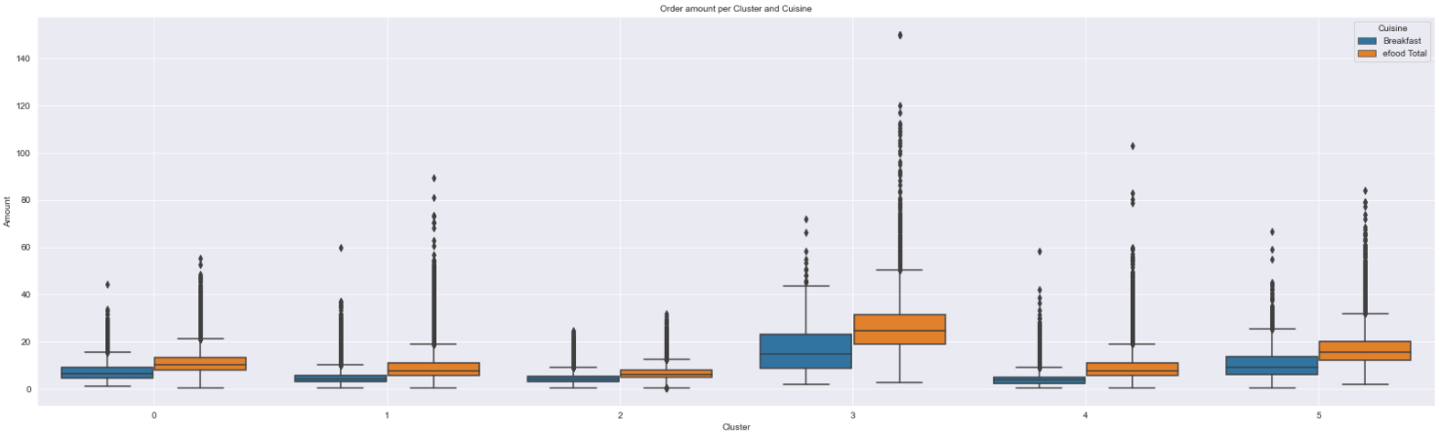
Cuisine per Cluster
Breakfast income from High-Value users (0-5-1),
Reduced breakfast orders from churn-risk and low-value

Slide 16
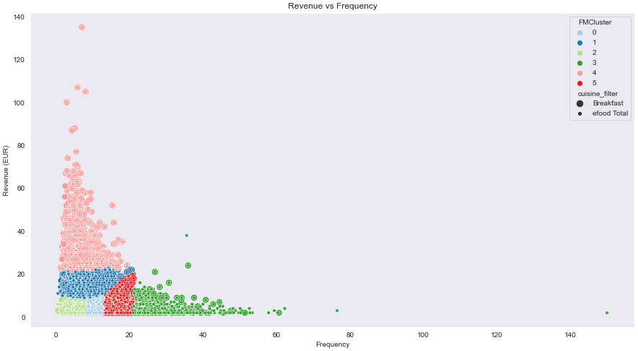
Clustering FM
Churn-risk customers in low frequency - revenue
Low-Value can be merged as deliver same frequency and multiple revenue width
High-Value produce same revenue (cluster 5 slightly increased)
Target in low breakfast revenue while frequency is high (cluster 4 – 1)
Churn-risk highly probable not to respond
Reward clusters 0,5,3 for breakfast performance or targeted marketing for more diverse selections

Slide 17
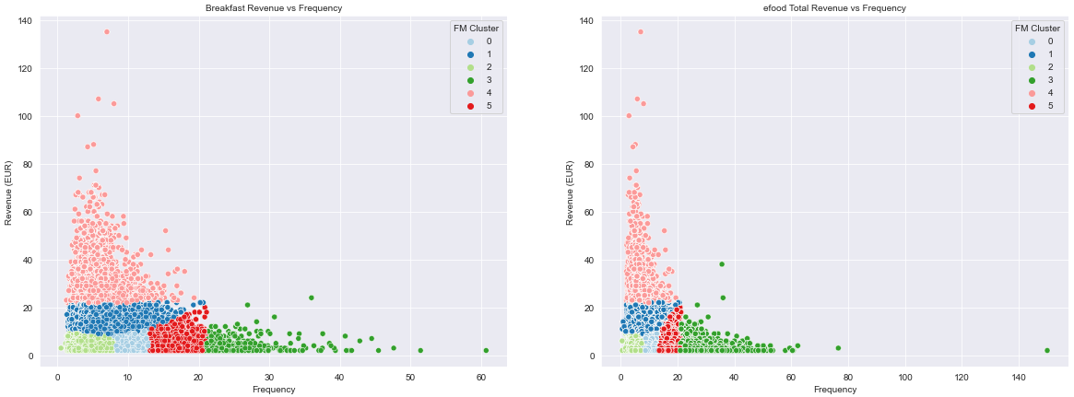
Clustering FM

Slide 18
Dashboard

Slide 19
Dashboard
Overall Daily Performance Overview for specific time duration
Brief overview for previous/new customers and share from different medium/channels
Improvements
Graph depict different shares in more than 1 cuisine
2 different Order Failure Ratio from customer and vendor side
New acquisitions separate basket
Observe behavior of new users so as to attract them easier

Slide 20
Dashboard
Overall Daily Performance Overview for specific time duration
Brief overview for previous/new customers and share from different medium/channels
Improvements
Different colors in lower graph
Different individual axis for Order Failure Ratio (it is minimized)

Slide 21
Dashboard
Overall Daily Performance Overview in geographical details
Improvements
Denote the Delta contribution on all categories (do not restrict to one cuisine)
Know exactly where the increase/decrease comes from
Null can be denoted in a formal way (Not Found)

Slide 22

Thank you :)

